Slide 1

Facebook Ad Performance
WebstaurantStore
Adrian Harriott

Slide 2

Agenda
Campaign objectives
Advertisement locations
Costs vs. revenue
Key Performance Indicators
Forecasting models
What’s next?

Slide 3

Introduction
Facebook is a platform where people can create posts, and check up on friends and family, but it is also the perfect platform to advertise for business and personal needs.
Facebook platforms have an estimated total of 2 billion users, both for business and personal use.
Today, we will see the performance of advertisements on Facebook owned platforms from 2020 and see if WebstaurantStore ads are making any effect.
We will also search to find any correlation between advertisements, Facebook platforms, and conversion.

Slide 4

Campaign Objectives
Let’s dive in

Slide 5
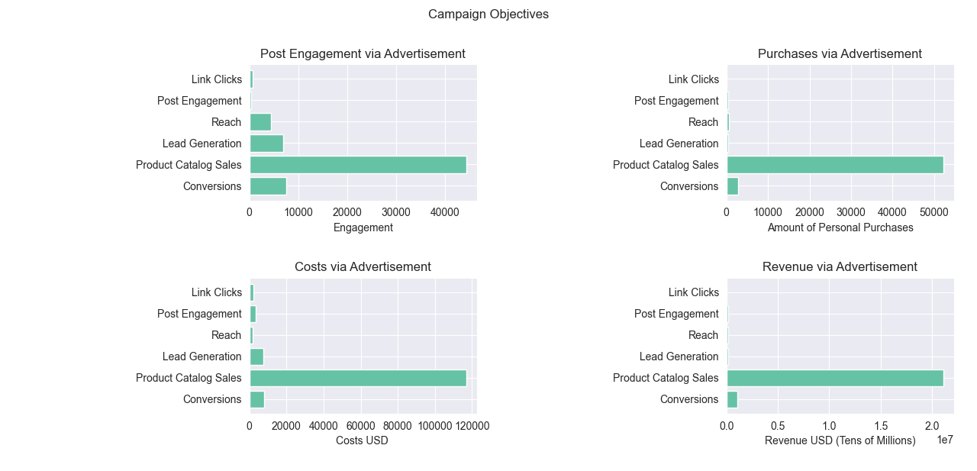
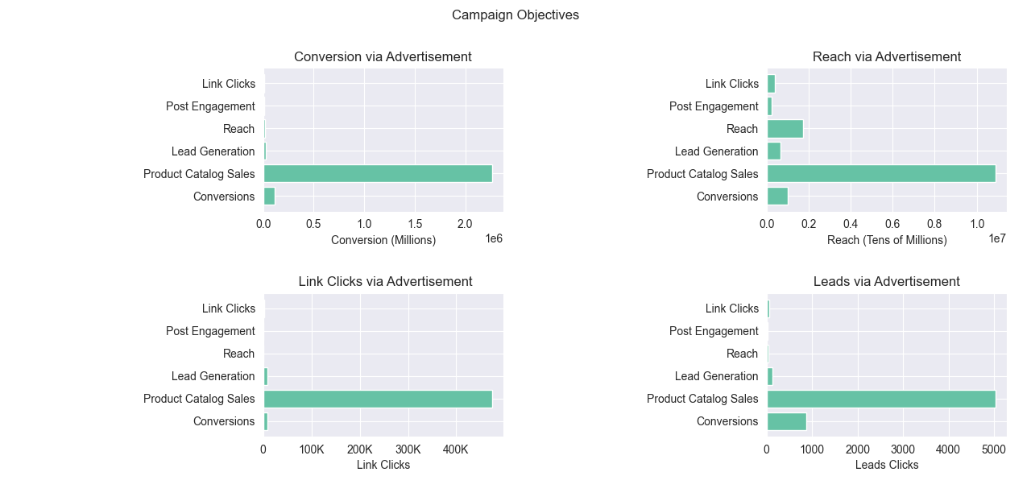
What Are The Ad Goals?
Each advertisement objective has a specific goal and audience to target.
The objectives described are:
Link Clicks
Post Engagement
Reach
Lead Generation
Product Catalog Sales
Conversion

Slide 6
Campaign Objective Results
Product Catalog Sales is the leader of each campaign objective, while also bringing in the most revenue.
People are drawn into advertisements with names such as “#1 Rated Supplier – Carousel” compared to other advertisement names.
Conversion advertisements are the second highest in revenue, with the ad name “Let WebstaurantStore Help” impacting leads and eventually turning leads into purchases.

Slide 7
Advertisement Locations
Let’s dive in

Slide 8
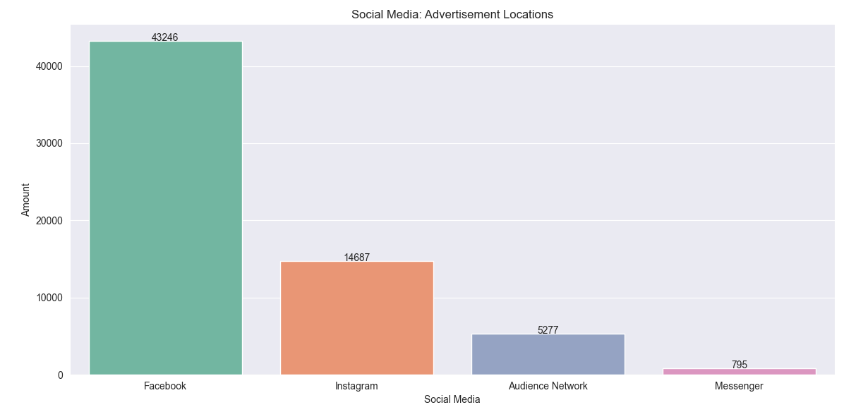
Where are our Ads being Displayed?
Facebook has four major platforms:
Facebook
Instagram
Audience Network
Messenger
There are three types of advertisements being displayed:
Links
Videos
Photos

Slide 9
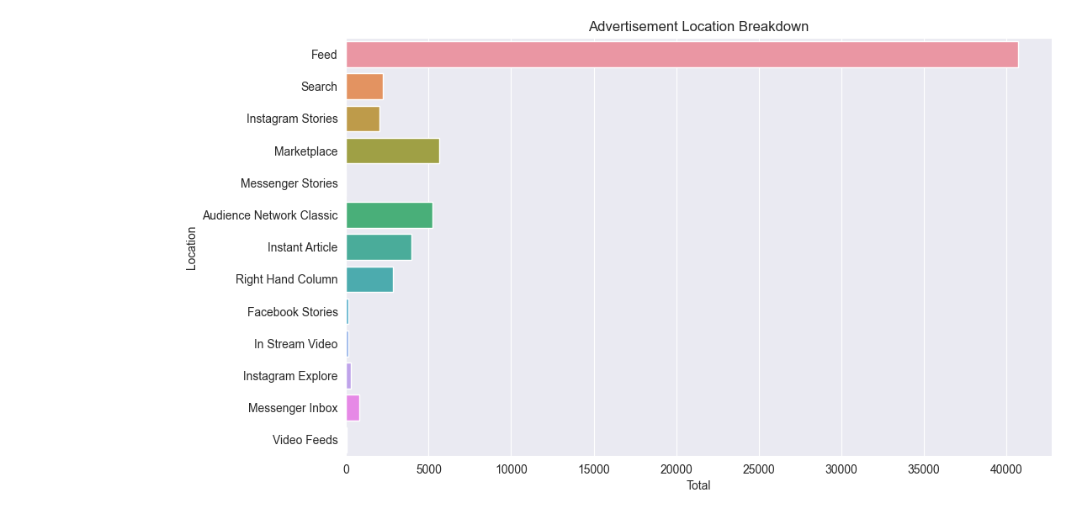
In Depth Breakdown

Slide 10
Costs vs. Revenue
Let’s dive in

Slide 11
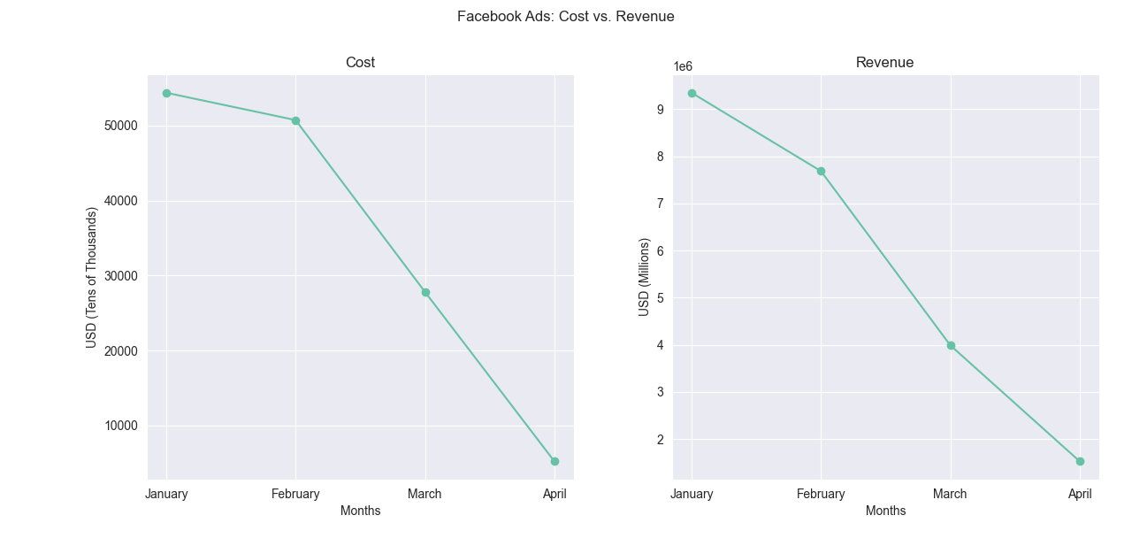
Costs
Business Insight
There is a downward trend for costs.
There are a total of 1,638 advertisements that are currently paused, which lowers the overall cost per ad.
The average cost per month for the first three months is $44,309.36
In total, the costs of ads are $138,164.06

Slide 12
Revenue
Business Insight
There is a downward trend for revenue.
The average amount of revenue per month for the first three months is $7,007,178.17
Overall, the total amount of revenue from ads are $22,549,697.12

Slide 13
Key Performance Indicators
Let’s dive in

Slide 14
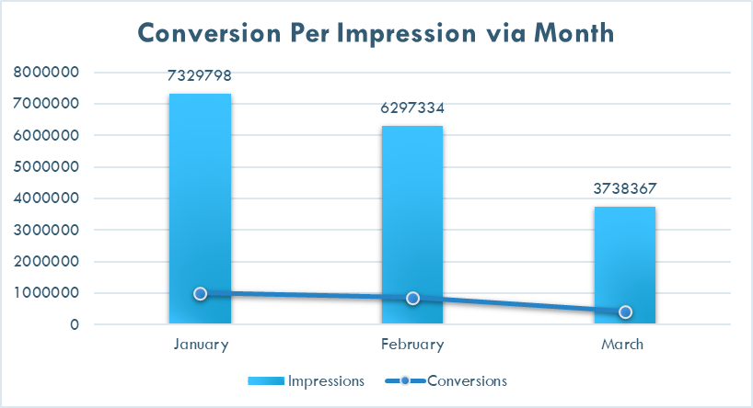
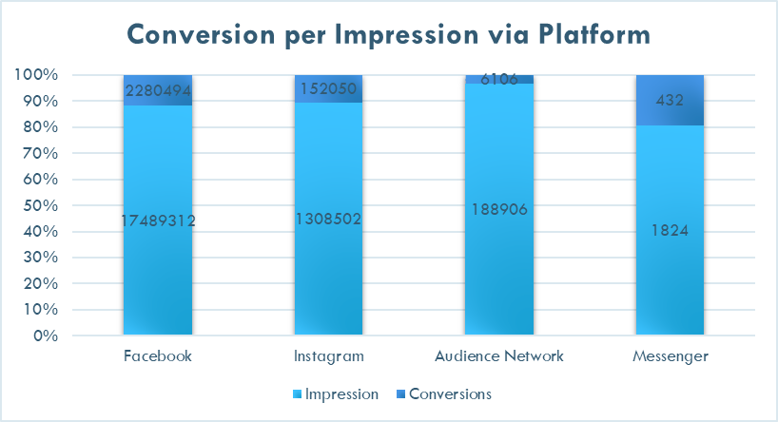
Current Performance
Metrics | Amount
Click Through Rate | 2.58%
Cost Per Action | $0.06
Cost Per Click | $0.24
Conversion Per Impression | 12.85%
Cost Per Mile | $7.28
Return On Ad Spend | $17.65

Slide 15
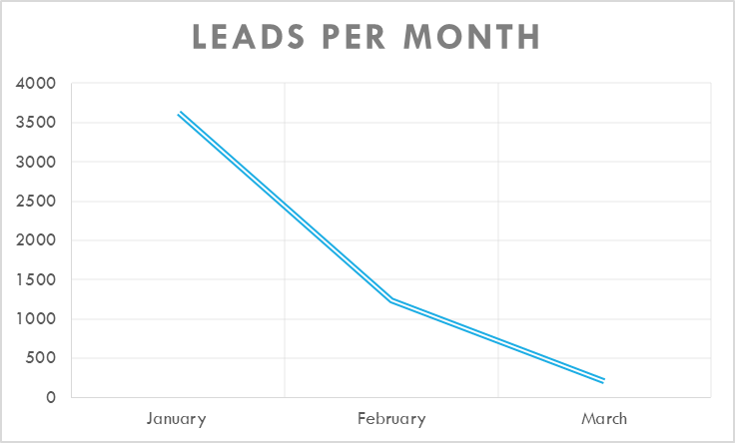
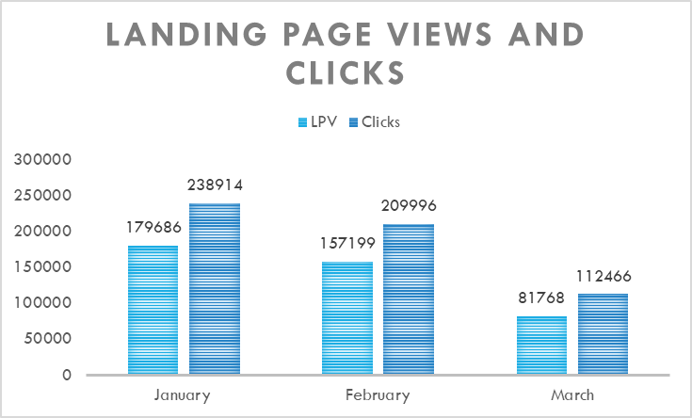
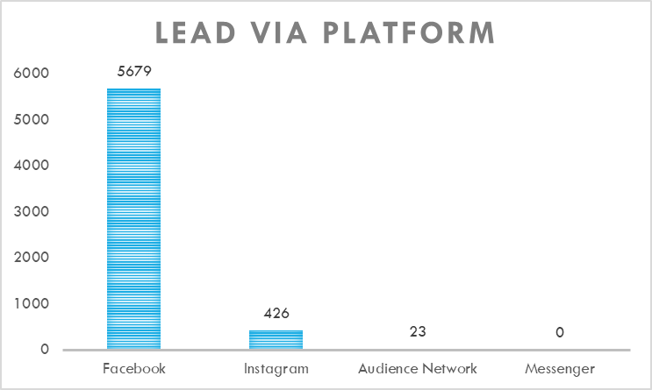
Leads and Views

Slide 16
Forecasting Models
Let’s dive in

Slide 17
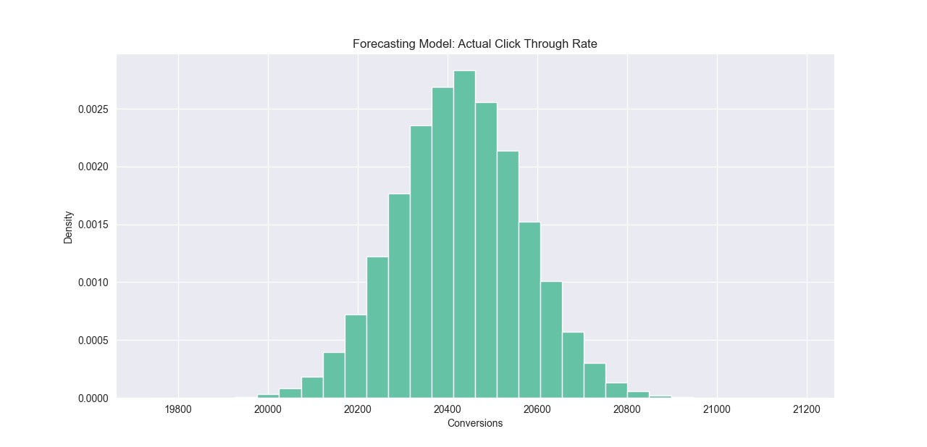
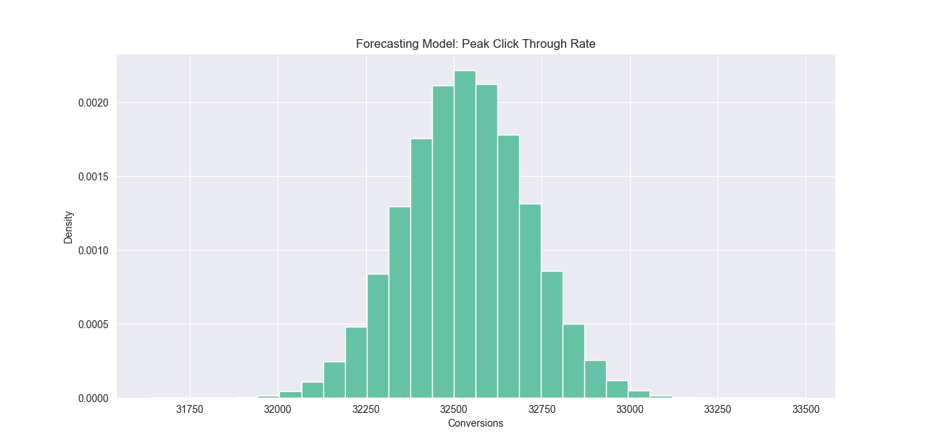
Click Through Rates

Slide 18

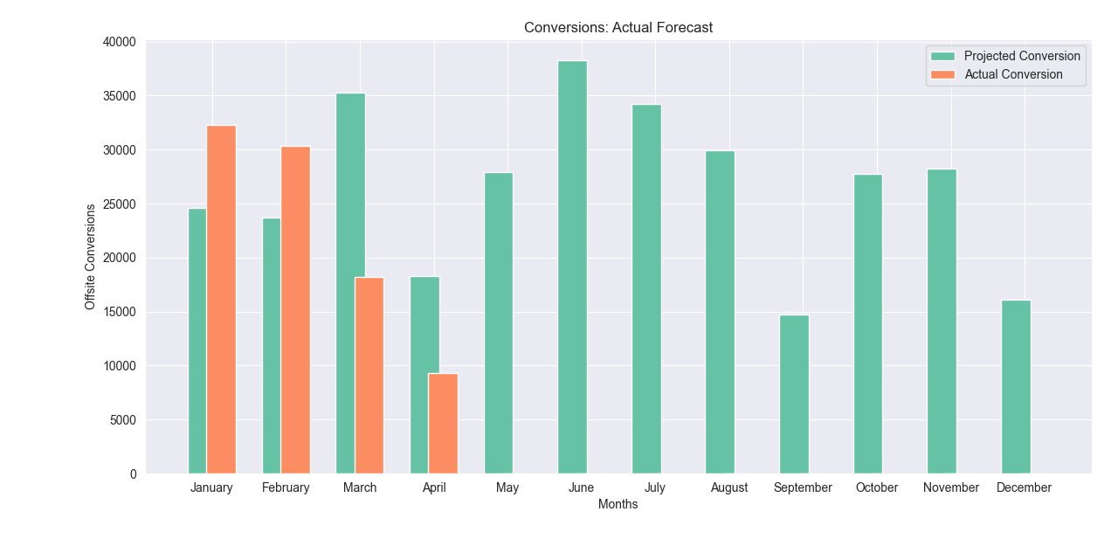
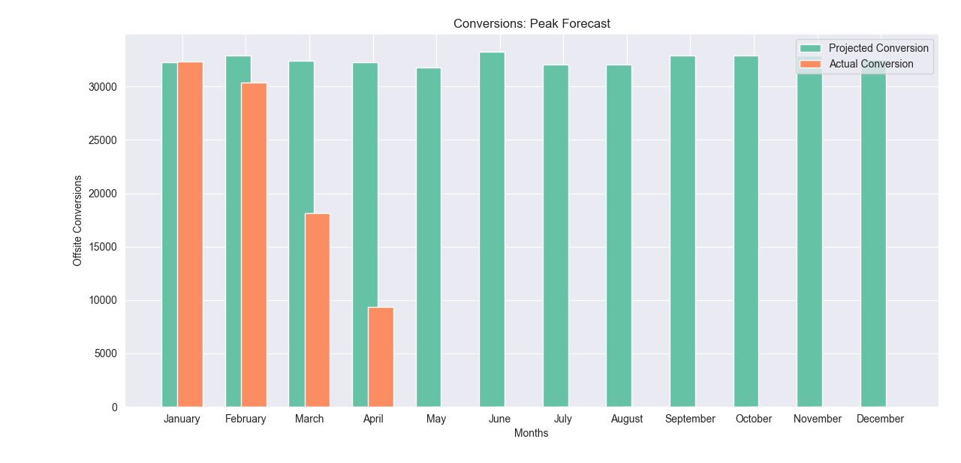
Projections

Slide 19

What’s Next?
Analysis of Variance
Results
Recommendations
An analysis of variance was conducted to see if there was a difference between the advertisement campaigns conversions and purchases made.
An analysis of variance was conducted to see if there was a difference between the platform's conversions and purchases.
Allocate the money spent on video ads to pictures. Video ads are not bringing in as much revenue compared to pictures and links.
Most platforms are not using the video platform as well.

